Slide 1

Problem Solving Session
The remainder of today’s class will comprise the problem solving session (PSS).
Your instructor will divide you into teams of 3 or 4 students.
Each team will work together to solve the following problems over the course of 20-30 minutes.
You may work on paper, a white board, or digitally as determined by your instructor.
You will submit your solution by pushing it to GitHub before the end of class.
Your instructor will go over the solution before the end of class.
If there is any time remaining, you will begin work on your homework assignment.
Class participation is a significant part of your grade (20%). This includes in class activities and the problem solving session.
Your graders will grade your participation by verifying that you pushed your solutions before the end of the class period each day.

Slide 2
Problem Solving 1
Def natural_num():
for i in range(0,100):
print(i)
Def negative_num():
for I in range(-1,-100, -1):
print(i)
Def even_num():
for I in range (50,150,2):
print(i)
Def pos_multiples():
for I in range(5,500,5):
print(i)
Def odd_neg_num():
for I in range(0,-1000):
print(i)
Use the space to the right to write a for loop that prints each of the integer ranges described below. If you need more space, duplicate this slide.
The first 100 natural numbers.
The first 100 negative numbers in increasing order.
Even numbers between 50 and 150.
Positive multiples of 5 less than or equal to 500.
Odd negative numbers greater than -1000 in decreasing order.

Slide 3
Problem Solving 2
Word_by_word(“this is a test”)
Def word_by_word(string):
Range = string.split(“ “)
for word in range:
print(words)
Write a function that uses a for loop to print each word in a string on a separate line without using the split() function.
Hint: Iterate over the characters in the string and check for spaces.
>>> word_by_word("this is a test")
this
is
a
test
>>>

Slide 4
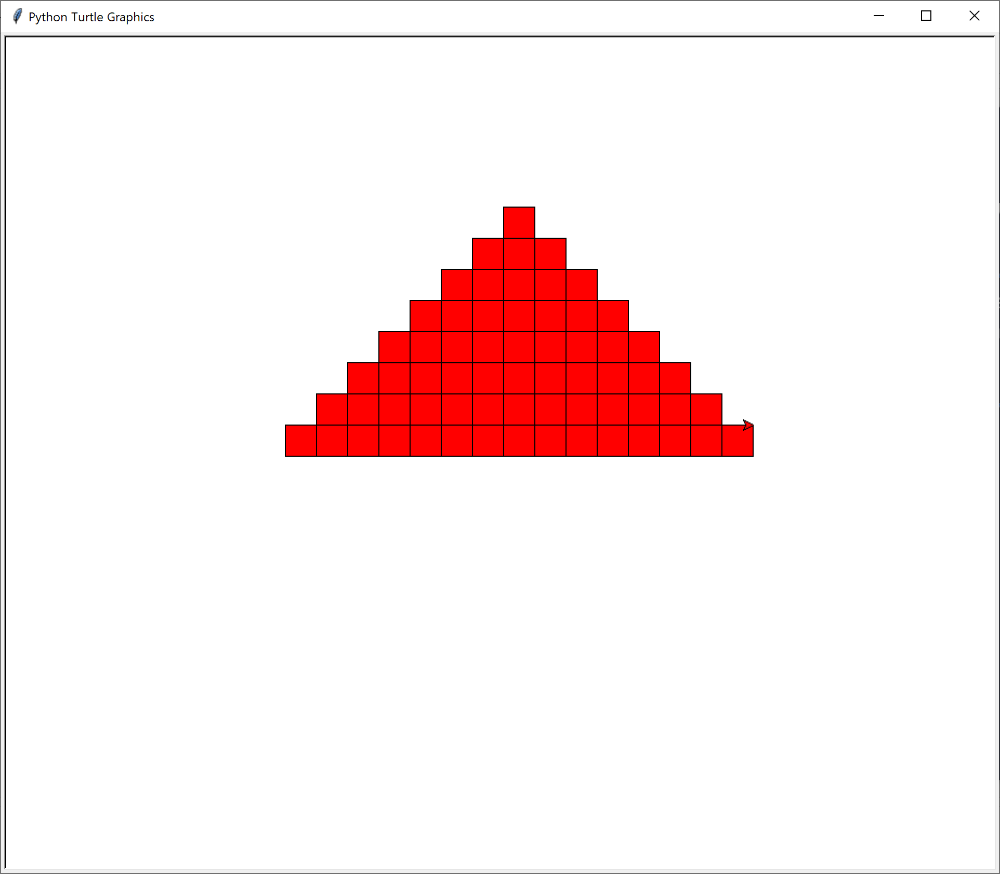
Problem Solving 3
Def triangle(row,column,height,color):
for I in range(0,height):
draw_row(row + 1, column - 1, width + 2, color)
I think you add I to one of the variables on the width
??
Write a function for your shapes module that, given a row, column, height, and color, draws a triangle, e.g triangle(2, 10, 8, "red")
The row and column indicate the location of apex of the triangle.

Slide 5
Problem Solving 4
Def test_draw_triangle():
p.init()
p.draw_triangle(2, 10, 8, "red") assertle(x coordinate, ycoordinate, “red”)
I don’t think that it will be enough because we also need if the height also prints correctly
Write a test function for your triangle drawing function. What input values will you use? What can you assert after the triangle is drawn?
Will this test be sufficient to determine whether or not the function is working? Why or why not?

Slide 6
Problem Solving 5
Describe the format of the string (and give examples):
R C H COL (“5, 2, 5, “red”)
Your draw triangle function needs to be given the row, column, height, and color of the triangle to draw.
Work together with your team to determine how to encode this information into a single string that the user may type into a prompt. How would you separate each of the four different pieces of required information from each other? Keep in mind that the row, column, and height may be more than one digit.
Then, write a function that will take a string in the same format, extract the required information from the string, and then call your triangle drawing function.
# implement your funct
def triangle_properties(triangle)
tokens = triangle.split()
row = tokens[0]
col = tokens[1]
height = tokens[2]
color = tokens[4]
draw_triangle(row,column,height,color)

